Slide 1





Install and Configure PHP: XAMPP, LAMP, IDEs
PHP, CGI, Web Server. XAMP / LAMP / PHP in IIS. PHP IDEs
SoftUni Team
Technical Trainers
Software University
http://softuni.bg

Slide 2

Table of Contents
PHP, Web Servers, HTTP, CGI
XAMPP: Install and Configure
PHP in IIS: Install and Configure
LAMP: Install and Configure
Configuring PHP: php.ini
Configuring Apache: httpd.conf
PHP IDEs: Aptana, PHP Storm, Netbeans

Slide 3



PHP, Web Servers, HTTP, CGI

Slide 4
What is PHP?
PHP is a server-side scripting language
Designed for Web development
Mix HTML with PHP to create dynamic Web pages
Can be used as general purpose language, e.g. for desktop and command-line apps
Free and open-source: http://php.net
Huge popularity: 240 millions sites run PHP in 2013
PHP: Hypertext Preprocessor (a recursive acronym)

Slide 5
PHP – Example
<!DOCTYPE html>
<html>
<body>
<h1>PHP Example</h1>
<?php
for ($i=0; $i<10; $i++) {
echo $i . "<br>\n";
}
?>
</body>
</html>

Slide 6
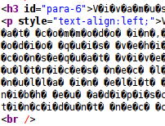
Cyrillic symbols in your webpage
Content-type
Defines the information that the file holds
Charset (if needed)
Defines the encoding of the file
File encoding
Always save your files with encoding UTF-8 to avoid issues
<?php header('Content-Type: text/html; charset=utf-8'); ?>

Slide 7




Web Servers
A Web server is a software application that serves Web content over the HTTP protocol
Hosts Web sites, Web applications and REST services
Processes HTTP requests and returns static / dynamic Web content (HTML, CSS, images, JSON, JS)
Runs server side scripts like PHP, Python and Ruby
Typically a client (Web browser) requests a Web page, the Web server builds the page and returns it

Slide 8

What is HTTP?
Hyper Text Transfer Protocol (HTTP)
Client-server protocol for transferring Web resources
HTML files, CSS styles, images, scripts, JSON data, etc.
Important properties of HTTP
Request-response model
Text-based format
Relies on a unique resource URLs
Stateless (cookies can overcome this)

Slide 9
HTTP – Example
Sample HTTP request:
Sample HTTP response:
The empty line denotes the end of the request header
GET / HTTP/1.1
Host: softuni.bg
User-Agent: Mozilla/5.0
HTTP/1.1 200 OK
Server: Microsoft-IIS/8.5
Date: Thu, 17 Jul 2014 12:11:44 GMT
Content-Length: 8560
<!DOCTYPE html>
…
The empty line denotes the end of the response header

Slide 10
What is CGI?
CGI == Common Gateway Interface
An interface to connect Web servers with server-side scripts
E.g. connect PHP with Apache or Python with IIS
Goal: generate dynamic Web content
Web server passes the HTTP request and produces HTTP response
Many technologies to connect Web servers with server scripts:
CGI, FastCGI, Apache modules, ISAPI (IIS), WSGI, Ruby Rack, …
E.g. mod_php, mod_python, mod_wsgi, …

Slide 11
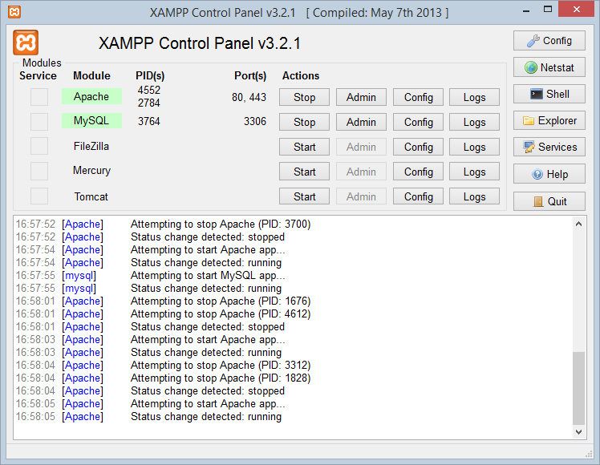

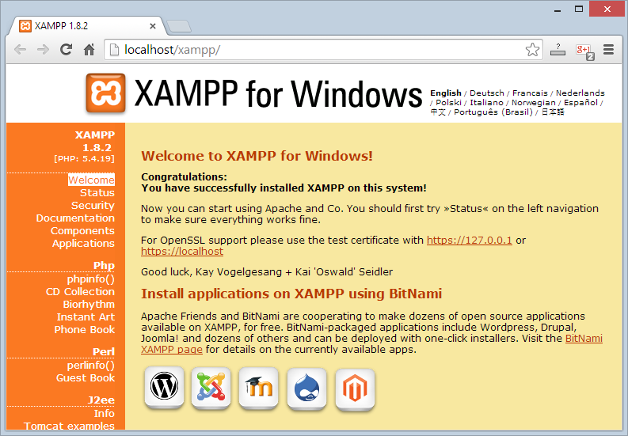
XAMPP
Install and Configure XAMPP

Slide 12
What is XAMPP?
XAMPP (/ˈzæmp/ or /ˈɛks.æmp/)
Free, open source cross-platform Web server solution stack
Runs in Windows, Linux and Mac OS X
Apache Web server + OpenSSL
MySQL database + phpMyAdmin
Scripting languages: PHP and Perl
FileZilla FTP server
Mercury mail server (SMTP and POP3)
Provides an admin panel for simplified administration

Slide 13
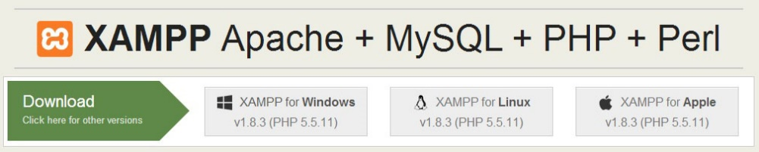
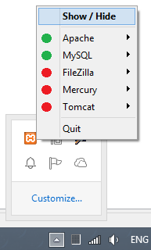
Download, Install and Run XAMPP
Downloading XAMPP:
https://www.apachefriends.org/download.html
Installing XAMPP for Windows:
Download the installer (run it as administrator)
Usual Windows installation: Next -> Next -> Finish
Running XAMPP
XAMPP start as a tray icon

Slide 14
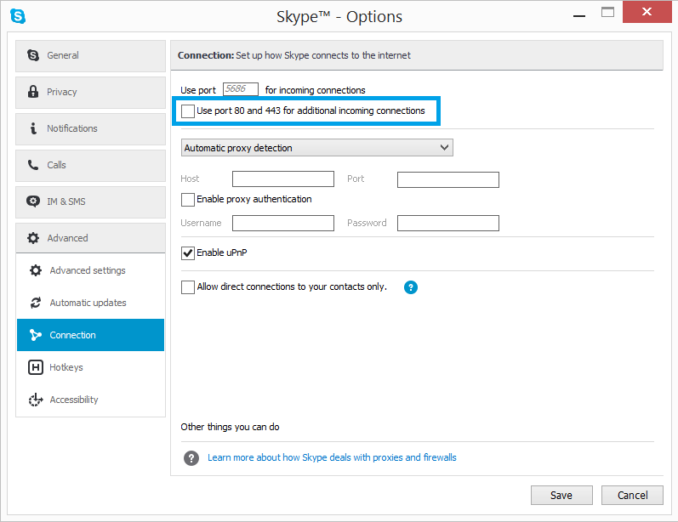
XAMPP: Collision with Skype

Slide 15
Changing the Apache HTTP Port
You may have IIS or other Web server running on your machine
This will take the standard HTTP and HTTPS ports: 80 and 443
You may change the Apache HTTP listening port
From XAMPP Control Panel choose Apache -> Config
This will open .\apache\conf\httpd.conf
Search for “Listen 80”
Replace with “Listen 8080” (for example)
Access XAMPP from http://localhost:8080

Slide 16
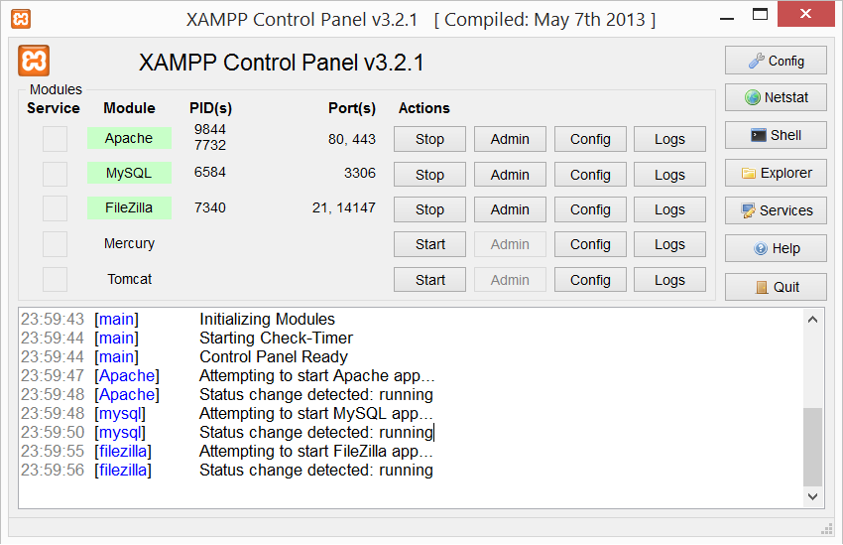
XAMPP Control Panel
Used TCP ports
Windows process IDs
System messages (logs)

Slide 17
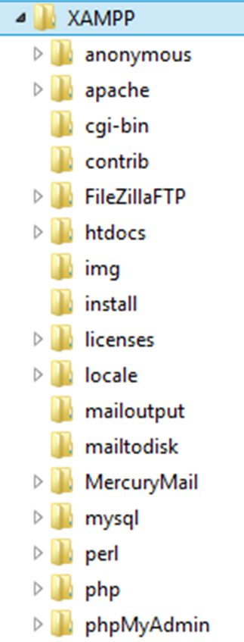
XAMPP Directories
Location of public HTML files (document root)
./htdocs
Location of Apache web server
./apache
Location of PHP
./php
Location of MySQL database
./mysql

Slide 18
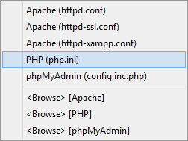

XAMPP Configuration Files
Apache configuration file (httpd.conf)
.\apache\conf\httpd.conf
PHP configuration file (php.ini):
.\apache\bin\php.ini
MySQL configuration file (my.cnf):
.\mysql\bin\my.cnf

Slide 19
XAMPP
Live Demo

Slide 20

PHP in IIS
Running PHP in Microsoft Internet Information Services (IIS)

Slide 21
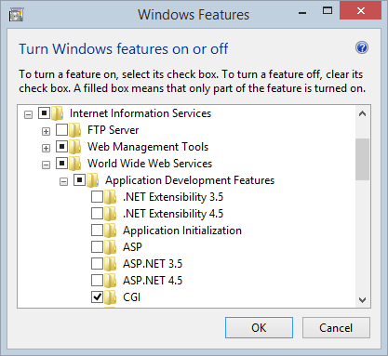

PHP in IIS
Installing IIS:
Turn Windows features on or off → Internet Information Services
Install HTTP Features, CGI and IIS Management Console
Integrating PHP in IIS:
Install PHP Manager for IIS from http://phpmanager.codeplex.com
Register new PHP version

Slide 22
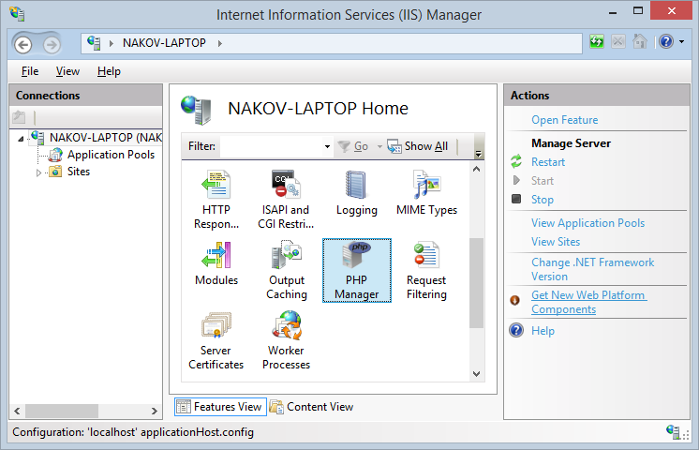
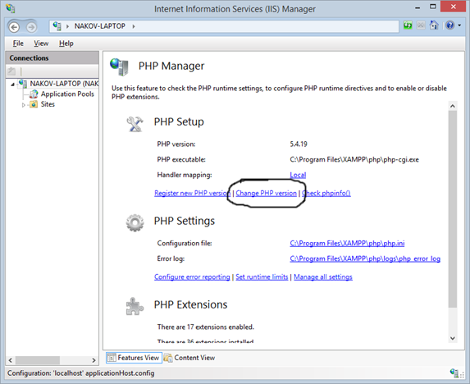
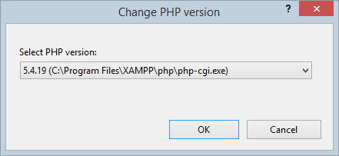
PHP in IIS (2)

Slide 23

LAMP
Linux, Apache, MySQL, PHP

Slide 24
What is LAMP?
LAMP stands for Linux, Apache, MySQL, PHP
An open source Web development platform
Linux – server operating system
Apache – Web server
MySQL – relational database management system
PHP – object-oriented server-side scripting language
LAMP is an application development platform
Not just a software bundle

Slide 25
Download and Install on Ubutntu
Open terminal, then just type:
Apache document root: /var/www/html
Start / stop Apache service (in Ubuntu)
Create a PHP script /var/www/html/index.php
Test it by opening http://localhost/index.php
sudo apt-get install lamp-server^
sudo service apache2 start | stop | restart

Slide 26

PHP Settings
The php.ini File

Slide 27
PHP Settings
PHP settings (called directives) are stored in the php.ini file
A set of name = value statements
If there is no value, the directive is left as name =
Comments start with a semicolon ;
The location of the file is different across operating systems and versions
You can check which php.ini file is loaded with phpinfo()
PHP supports add-ons
Most add-ons read their settings from the same file

Slide 28
Sample php.ini Settings
Directive | Default | Description
short_open_tag | Off | Whether <? and ?> tags should be allowed
asp_tags | Off | Whether <% and %> tags should be allowed
post_max_size | “8M” | The maximum size of post data allowed
default_charset | “UTF-8” | The default charset of the HTTP response
upload_max_filesize | “2M” | The maximum size of an uploaded file
max_execution_time | 120 | Execution time limit of a script in seconds
user_dir | NULL | The user’s home directory for PHP files

Slide 29
Changing Settings at Runtime
Get the runtime value of a php.ini variable:
Change the value of a php.ini variable at runtime:
Display the current values of the PHP settings:
ini_get("upload_max_filesize");
ini_set("include_path", "c:/php/PEAR");
phpinfo();

Slide 30
Enable XDebug in php.ini
By default PHP does not support debugging
You may enable the XDebug Zend extension in the php.ini
[XDebug]
zend_extension = "C:\XAMPP\php\ext\php_xdebug.dll"
xdebug.remote_enable = 1
xdebug.remote_handler = dbgp
xdebug.remote_host = localhost
xdebug.remote_port = 9000

Slide 31

Apache Settings
The httpd.conf file

Slide 32
Apache Settings
Apache settings are defined in the httpd.conf file
Location and name may differ across platforms and Apache versions
Older version read from multiple files
The site-specific settings and module-specific settings are in separate files
Follows a syntax close to XML
Name-value pairs sometimes in tags

Slide 33
Sample httpd.conf Settings
Directive | Default | Description
Listen | 80 | Sets the port to listen for connections; can be repeated with different ports; usually specified in ports.conf file
TimeOut | 300 | The number of seconds before the server sends timeout to a dead connection
KeepAlive | On | Turns persistent connection on or off
ErrorLog | logs/error_log | Sets the Apache log file; can be specified separately for each site
DirectoryIndex | index.html | Sets the default files in a directory (when the user requests the directory)

Slide 34



PHP IDEs
Aptana, PHP Storm, Netbeans

Slide 35
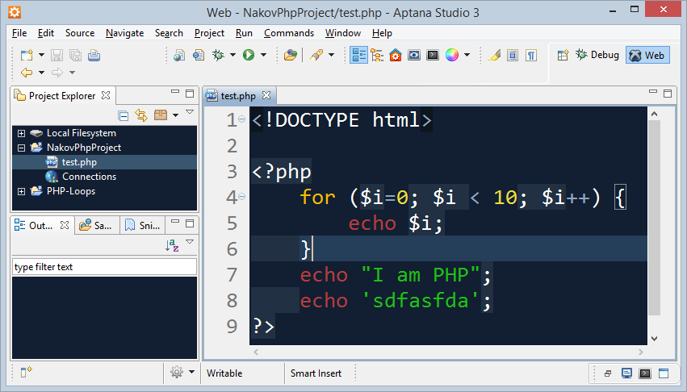
Eclipse / Aptana
The Eclipse platform provides solid PHP development support
PDT – PHP Development Tools
Write PHP code, Web server integration, debugging (XDebug)
Free, open-source: http://www.eclipse.org/pdt/
Aptana Studio
Eclipse-based IDE for PHP, Ruby, Python
Supports also HTML, CSS, JavaScript
Open-source: http://www.aptana.com

Slide 36
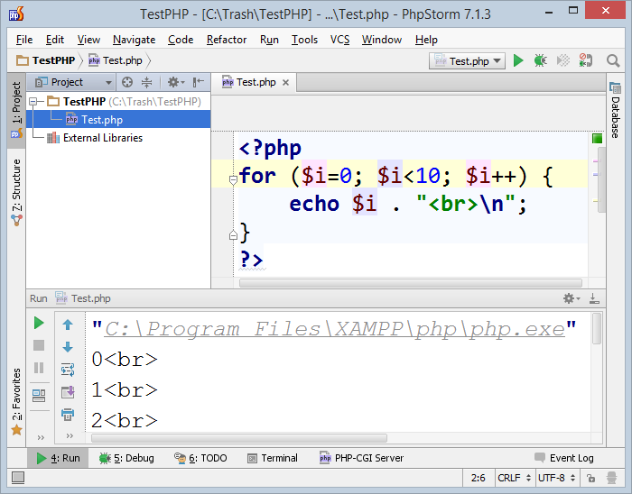
PHP Storm
PHP Storm
Powerful PHP IDE
By JetBrains, paid product
Built-in Web server for simplified configuration
Easy to install and configure
http://jetbrains.com/phpstorm/

Slide 37
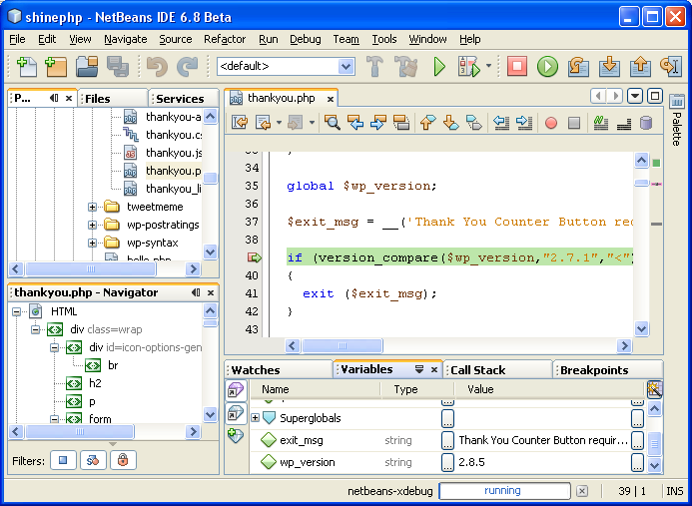
NetBeans for PHP
The NetBeans IDE fully supports PHP
Free, open-source IDE
PHP code editor
Debugger (through XDebug)
Server integration
Frameworks support:
Symfony2, Zend

Slide 38

Resources
General information about PHP
http://php.net/
Partly in Bulgarian
Good practices when writing PHP code
http://www.phptherightway.com
https://phpbestpractices.org

Slide 39


Summary
PHP == server-side Web scripting language
Web Servers serve web content through HTTP
Run PHP through CGI / mod_php / ISAPI
XAMPP == Apache + PHP + MySQL + Perl
Recommended for Windows users
LAMP == Linux + Apache + MySQL + PHP
php.ini holds the PHP interpreter settings
PHP IDEs: Aptana, PHP Storm, Netbeans
PHP Basics

Slide 40









Install and Configure PHP: XAMPP, LAMP, IDEs
https://softuni.bg/courses/php-basics/

Slide 41
License
This course (slides, examples, demos, videos, homework, etc.) is licensed under the "Creative Commons Attribution-NonCommercial-ShareAlike 4.0 International" license

Slide 42




Free Trainings @ Software University
Software University Foundation – softuni.org
Software University – High-Quality Education, Profession and Job for Software Developers
softuni.bg
Software University @ Facebook
facebook.com/SoftwareUniversity
Software University @ YouTube
youtube.com/SoftwareUniversity
Software University Forums – forum.softuni.bg

